Slide 1

AI & Robotics
State space and game AI

Slide 2

Goals
The junior-colleague
can describe & explain in own words the position game AI as a subfield
can describe in own words the link between tree search and game AI
can explain in own words the differences between simple and more complex board games in context of game AI using real world games
can explain in own words the term “contingency” of a problem
can describe in own words how a game AI using tree search on an abstract level
can explain in own words Minimax in context of game AI
can explain in own words the time and space complexity of Minimax
can implement Minimax for a given problem
can explain in own words an improvement of Minimax
can implement an improvement of Minimax
can explain in own words Alpha-Beta pruning in context of game AI
can explain in own words the best case and worst case gain of Alpha-Beta pruning in context of game AI
can describe in own words the term Heuristic continuation in context of game AI and what problem it solves in context of Alpha-Beta pruning using a real world example
can implement Alpha-Beta pruning for a given problem
can implement Heuristic continuation for a given problem

Slide 3
Why?
One of the oldest subfields of AI
Abstract and pure form of competition that seems to require intelligence
Game playing is a special case of a search problem, with some new requirements.

Slide 4
How?
Simple board games
Easy to represent the states and actions
Very little world knowledge required!
“Contingency” problem:
=> We do not know the opponents move!
The size of the search space:
Chess : +/- 15 moves possible per state, 80 plays => 15⁸⁰ nodes in tree
Go : +/- 200 moves per state, 300 plays => 200³⁰⁰ nodes in tree
More complex games
State space representation becomes increasingly difficult
=> How to represent a game world?

Slide 5
How?
Game playing algorithms:
Search tree only up to some depth bound
Use an evaluation function at the depth bound
Propagate the evaluation upwards in the tree

Slide 6
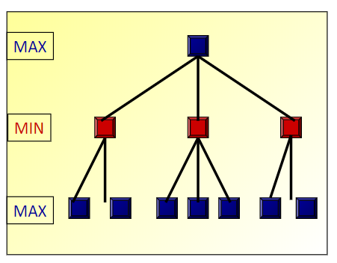
MiniMax
Consider a board game with 2 players:
MAX (AI player)
MIN (opponent)
Each player alternates between taking a turn
The game ends when either:
One of the 2 players reaches a winning state
No more moves are possible
Assumptions:
Deterministic
Perfect information

Slide 7
MiniMax
Select a depth-bound (say: 2) and evaluation function
Construct the tree up till the depth-bound
Compute the evaluation function for the leaves
MAX
MIN
MAX
2
5
3
1
4
4
3

Slide 8
MiniMax
MAX-player wants to maximize MIN-player’s ultimate score
MIN-player wants to minimize MAX-player’s ultimate score
=> Propagate the evaluation function Upwards:
Take minima in MIN
Take maxima in MAX
MAX
Select
this move
3
MIN
2
1
3
MAX
2
5
3
1
4
4
3

Slide 9
MiniMax
init depthBound
function miniMax(board, depth):
if depth == depthBound
return eval(board)
else if maximizer(depth)
for each child c of board
value = max(value, miniMax(child, depth + 1))
return value
else [minimizer]
for each child c of board
value = min(value, miniMax(child, depth + 1))
return value

Slide 10
MiniMax
Analysis
Time complexity
=> Same as iterative deepening (search bounded by depth m): O(b^{m})
Space complexity
=> Same as iterative deepening (search bounded by depth m): O(b*m)

Slide 11
MiniMax: Tic-Tac-Toe
2 players: X and O
State representation of the board: i.e. matrix
Production rules:
X move: place X on a free spot on the board
O move: place O on a free spot on the board
Start state: empty board
Goal state:
3 X’s in a row
3 O’s in a row
Full board

Slide 12
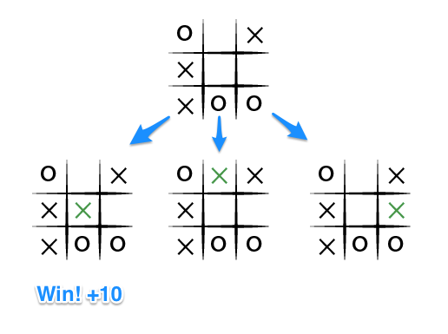

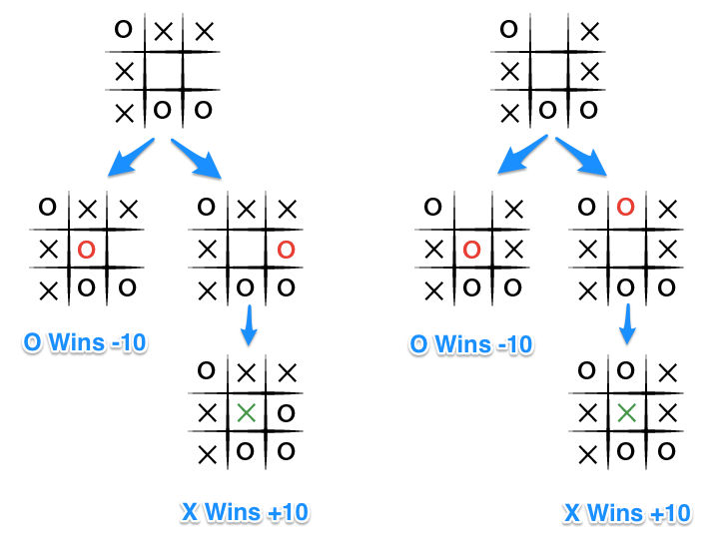
MiniMax: Tic-Tac-Toe
MAX-player (X) wins: +10
MIN-player (O) wins: -10
function eval(board, depth):
if maximizer(depth)
return 10
else if minimizer(depth)
return -10
else
return 0
Notes:
https://www.neverstopbuilding.com/blog/minimax

Slide 13
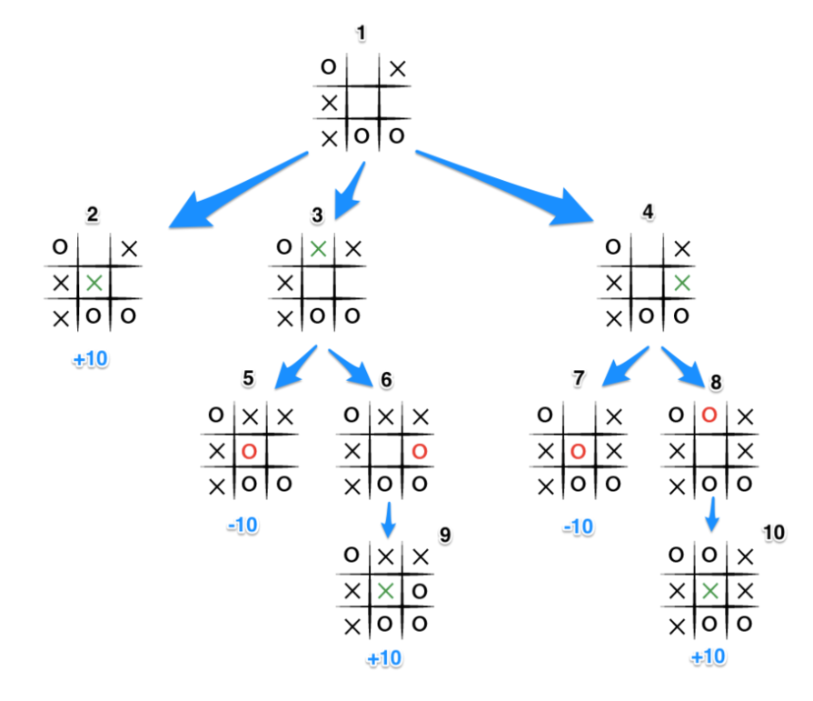
MiniMax: Tic-Tac-Toe
MAX-player X's turn in State 1
State 1: generates states 2, 3, and 4 and calls minimax on those states
State 2: goal state
=> X win: return +10 to state 1
State 3: generates states 5 and 6 and calls minimax on them
State 4: generates states 7 and 8 and calls minimax on them
State 5: goal state
=> O win: return -10 to state 3
State 7: goal state
=> O win: return -10 to state 4

Slide 14


MiniMax: Tic-Tac-Toe
State 6 and 8: generate states 9 and 10 and call minimax on them
State 9 and 10: goal states
=> return +10 to states 6 and 8
=> return +10 to states 3 and 4
State 3 and 4: O’s turn
=> MINimize score: MIN(-10, +10) = -10
=> states 3 and 4 return -10
State 1: X’s turn
=> MAXimize score MAX(+10, -10, -10) = +10
=> Choose State 2

Slide 15
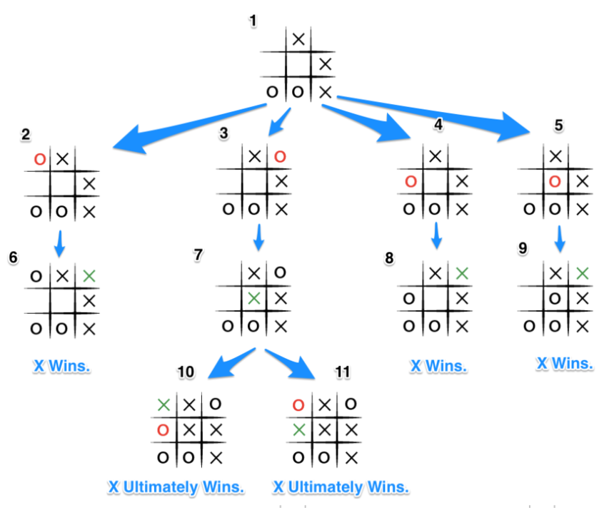
MiniMax: Improvement
Problem
Early demise: algorithm doesn’t differentiate between an early and a late defeat
=> O player could choose state 2, 4 or 5 instead of state 3

Slide 16
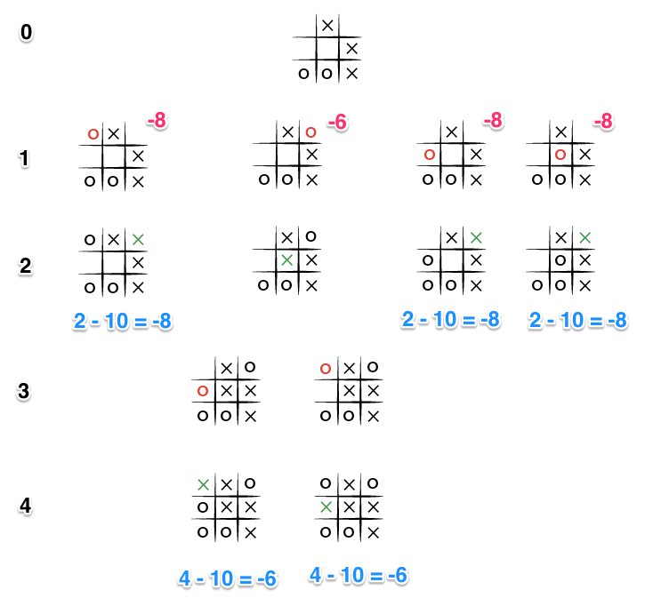

MiniMax: Improvement
Solution
Delay demise: take depth into account for evaluation score
MAX
MIN
function eval(board, depth):
if maximizer(depth)
return 10 - depth
else if minimizer(depth)
return depth - 10
else
return 0
MAX
MIN
MAX

Slide 17
Alpha-Beta pruning
Optimization for MiniMax
Instead of:
first creating the entire tree (up to depth-level)
then doing all propagation
Interleave the generation of the tree and the propagation of values.
=> some of the obtained values in the tree will provide information that other (non-generated) parts are redundant and do not need to be generated.

Slide 18
Alpha-Beta pruning
Generate the tree depth-first, left to right
Propagate final values of nodes as initial estimates for their parent node
The MIN-value (1) is already smaller than the MAX-value of the parent (2)
The MIN-value can only decrease further
The MAX-value is only allowed to increase
No point in computing further below this node
MAX
≥ 2
MIN
≤ 2
= 2
≤ 1
MAX
2
5
1

Slide 19
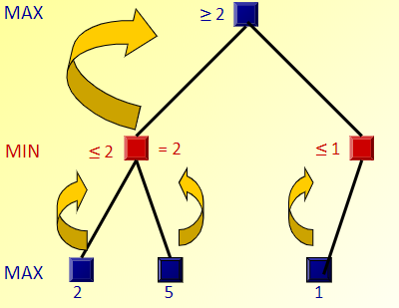
Alpha-Beta pruning
The values at MAX nodes are Alpha-values
The values at MIN nodes are Beta-values
Alpha-value
Beta-value

Slide 20
Alpha-Beta pruning
If an Alpha-value is larger or equal to the Beta-value of a descendant node:
=> Stop generation of the children of the descendant
MAX
≥ 2
Alpha-value
≥
MIN
≤ 2
=2
≤ 1
Beta-value
MAX
2
5
1

Slide 21
Alpha-Beta pruning
If an Beta-value is smaller or equal to the Alpha-value of a descendant node:
=> Stop generation of the children of the descendant
MAX
≥ 2
MIN
≤ 2
=2
≤ 1
Beta-value
≥
MAX
Alpha-value
2
5
3

Slide 22
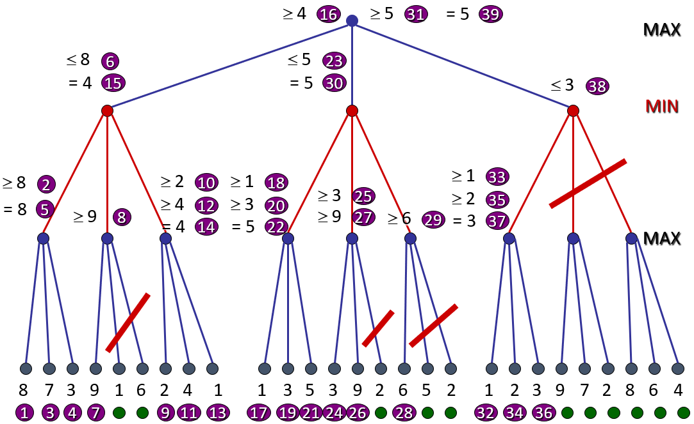
Alpha-Beta pruning

Slide 23
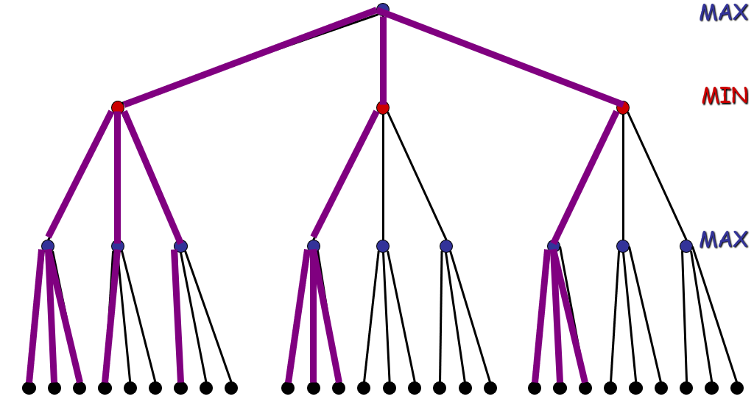
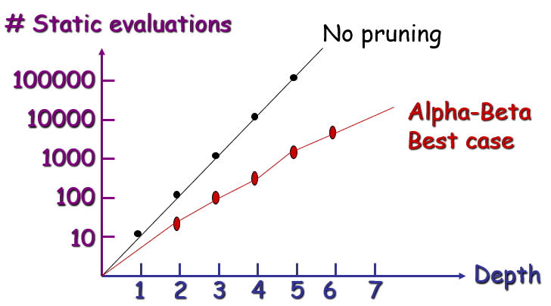
Alpha-Beta pruning
Best case gain:
At every layer, the best node is the left-most one:
=> only a is explored
Evaluations saved: O(b^{d/2})
Worst case gain:
No improvement

Slide 24
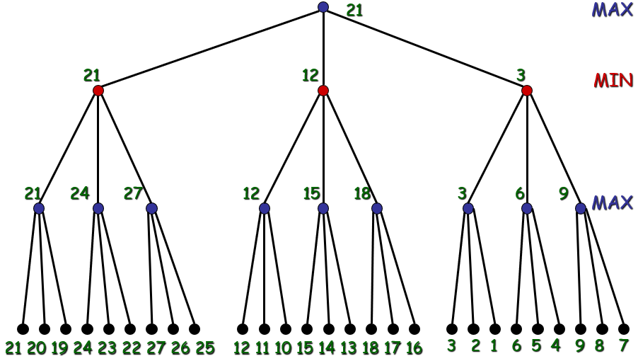
Alpha-Beta pruning
Best case gain:
Example of a perfectly ordered tree

Slide 25
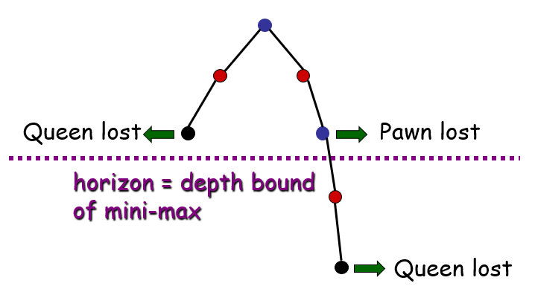
Alpha-Beta pruning: Problem
Depth-bound is limiting factor
It’s preferable to delay disasters, but they are not prevented
=> possible solution: heuristic continuation

Slide 26
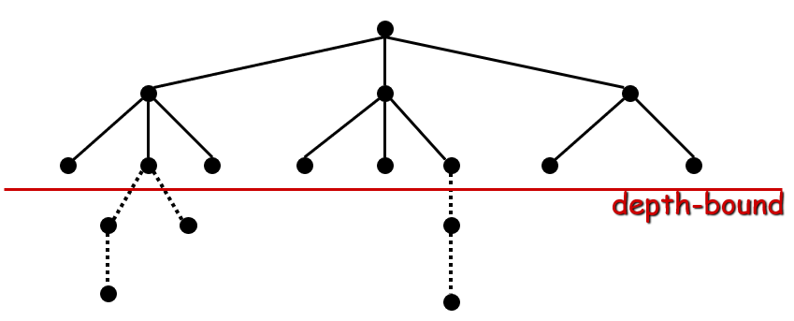
Alpha-Beta pruning: Heuristic continuation
Change behaviour in certain situations
Strategically crucial:
e.g. chess: king in danger, pawn can convert to queen, etc
=> extend search beyond the depth bound

